Slide 1
Introduction to Processing Digital Sounds part 2
Barb Ericson
Georgia Institute of Technology
Sept 2005

Slide 2
Learning Goals
Introduce Sound manipulation as a way to review
  Arrays
  Declaring variables
  Sending objects messages
  Iteration (Loops)
  Writing methods

Slide 3
Getting the Sound Sample Values
A Sound has many values in it
  Numbers that represent the sound at that time in the sample
You can get an array of SoundSample objects
  SoundSample[] sampleArray = sound1.getSamples();
Notes:
An array of objects is an array of object references. The value in the array is a reference to the actual object (a way to calculate where it is).

Slide 4
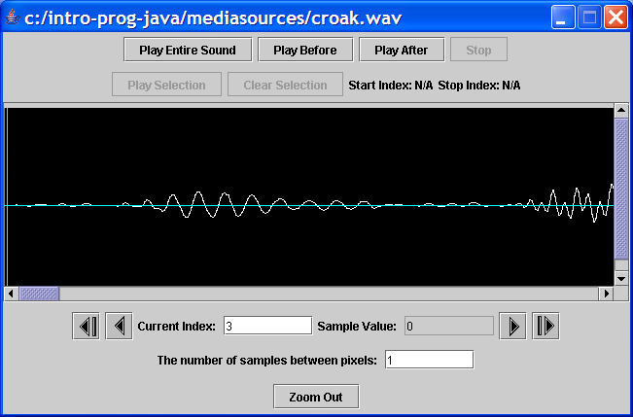
Explore the Sound Sample Values
Zoom in to see all the sound values
Click here to pick an index
See the value
Type in an index
Click here to go to the next index

Slide 5
Print the Sound Sample Value
You can get the SoundSample object from the array at an index
  SoundSample sample = sampleArray[0];
And then get the value from that
  System.out.println(sample.getValue());
What are the first 10 values of the Sound created from the file croak.wav?

Slide 6
Changing the Value of a Sound Sample
You can set the value of a SoundSample
  sample.setValue(value);
  This will change the value in the Sound object as well
So how would you change the value to the original value * 2?
    SoundSample sample = sampleArray[0];
    sample.setValue(sample.getValue() * 2);

Slide 7
Doubling all the Sound Values
You could change each SoundSample by hand
  There are 8808 SoundSamples in croak.wav
  Do you really want to do that?
    How long would it take you?
Let’s let the computer do it in a loop
  For-each
  While
  For

Slide 8
For-Each Loop (Java 5.0)
For each of the elements in a collection of objects do the body of the loop
  Each time through the loop the variableName will refer to a different object in the collection
for (type variableName : collection)
{
// statement to repeat
}
Notes:
Only use this if you are using Java 5.0 (1.5) or greater! It is not part of Java 1.4.

Slide 9
For-Each Loop to Process Sound Samples
SoundSample[] sampleArray = this.getSamples();
int value = 0;
for (SoundSample sample : sampleArray)
{
value = sample.getValue(); // get the value
sample.setValue(value * 2); // set the value
}

Slide 10
Increase Volume with For-Each Loop
public void increaseVolume()
{
SoundSample[] sampleArray = this.getSamples();
int value = 0; // value at sample
// loop through SoundSample objects
for (SoundSample sample : sampleArray)
{
value = sample.getValue(); // get the value
sample.setValue(value * 2); // set the value
}
}

Slide 11
Testing increaseVolume
String file =
FileChooser.getMediaPath(“gettysburg10.wav“);
Sound soundObj = new Sound(file);
soundObj.play();
soundObj.explore();
soundObj.increaseVolume();
soundObj.play();
soundObj.explore();

Slide 12
Decrease Volume Exercise
Write a method to decrease the volume of the sound
  decreaseVolume()
  Divide each value by 2
What parts need to change from the last method?
  Only the calculation of the new value
Try it:
  Sound s = new Sound(
  FileChooser.getMediaPath(“ gettysburg10.wav”));
  s.explore();
  s.decreaseVolulme();
  s.explore();

Slide 13
What Does For-Each Do?
It needs to use each element in the array one and only one time
  So it needs to keep track of the current index
  It needs to check that the current index is less than the length of the array
    And stop when they are equal
  It needs to increment the index after the loop body has executed
This is explicit in a while loop

Slide 14
Summary
Sound samples are stored in an array
  SoundSample[] sampleArray = this.getSamples();
You can get the SoundSample from an array
  SoundSample sample = sampleArray[0];
We can get and set the value of a SoundSample
  int value = sample.getValue();
  sample.setValue(value * 2);
For-Each Loop
  Use a for-each loop to repeat a statement or block of statements for each element in an array

